Slide 1
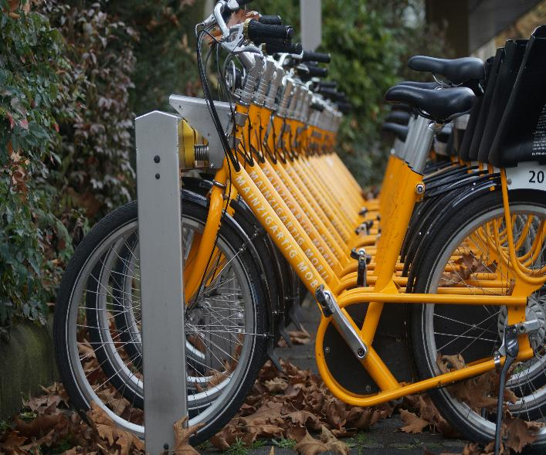
BIKE SHARING DEMAND ANALYSIS USING EXCEL
By Shailendra Nogia
Photo using Unplash from Pascal Muller
A PROJECT BY NEXTHIKES IT SOLUTIONS

Slide 2

Problem Statement:
Analyzing Bike sharing data helps understand how weather, time, and holidays affect bike rentals. This project uses Excel skills to clean, combine, and study datasets to find useful patterns that improve business planning.

Slide 3
Data Descriptions:
The bike sharing data contains information about bike rental from 1 Jan to 14 Feb 2011.
It contains observations of 16 columns, such as date, time, day, holiday, number of bikes rented (casual, registered, count), weather conditions (temp, humidity, windspeed) and other derived factors that may influence bike rental demand.
The dataset contains 1001 rows and 16 columns.

Slide 4
Bike Rental Factors that make it Popular are:
Faster way to communicate in cities with high traffic volumes.
Easy access. (No licence required)
Cheaper than automobiles services.
Environment friendly, free from Pollution , no carbon footprint.
Promote physical action and exercise.

Slide 5
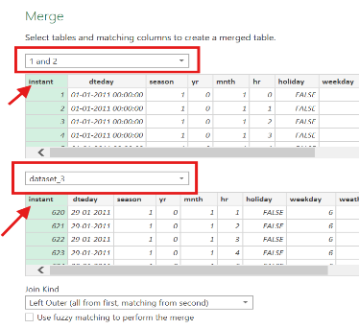
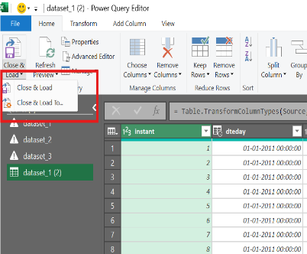
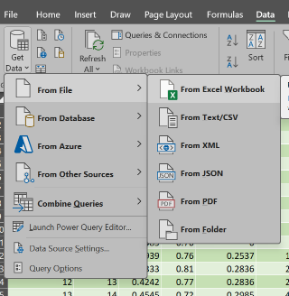
Data Preparation :
All Dataset Load using Get Data
Merge Datset having similar Columns
Power Query for
Merge data

Slide 6
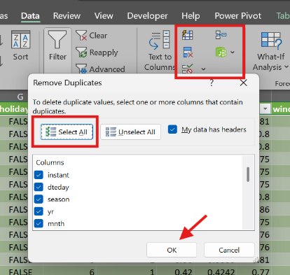
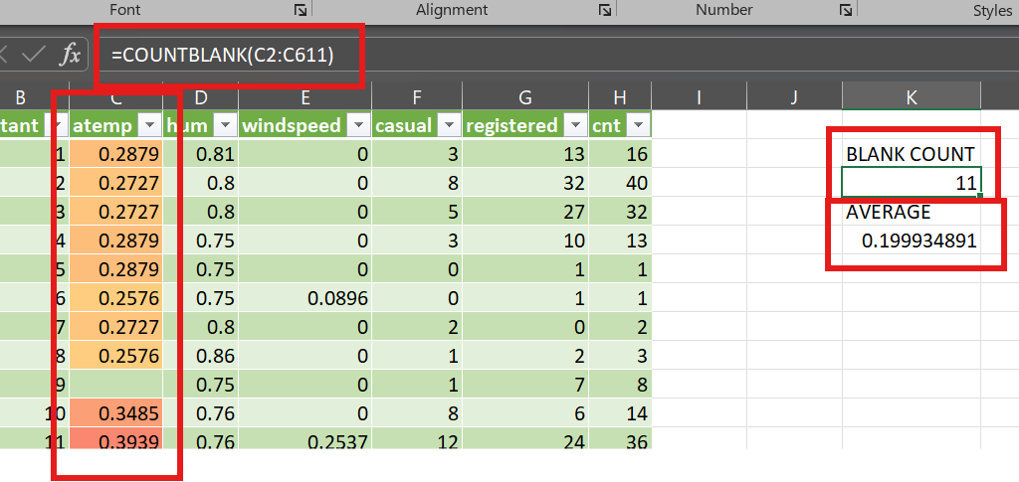
Data Validation:
1.Find missing value using BLANKCOUNT function.
2. Replace with AVERAGE of particular missing value.
Checking Duplicate
values if any

Slide 7
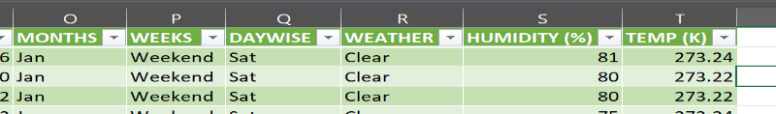
Data Integration:
From the mnth columns, ‘MONTHS’ column is created as Jan Feb using IF statement i.e. =IF(C2=1,"Jan","Feb")
From the weekday columns, ‘WEEKS’ column is created where 6 and 7 are Weekend and remaining are Weekdays using =IF(OR(F3=0,F3=6),"Weekend","Weekday")
Further Weekday are bifurcated into ‘DAYWISE’ =SWITCH(F3,0,"Sun",1,"Mon",2,"Tues",3,"Wed",4,"Thu",5,"Fri",6,"Sat")
Transforming weathersit column into WEATHER 1: Clear, 2: Mist, 3: Light Snow, 4: Snow.

Slide 8
Data Analysis using Pivot Table and Charts:
Numerical Data:
Hours
Temp
Humidity
Windspeed
Casual Rides
Registered Rides
Total Rides Count
Categorical Data:
Weather
Weekend/Weekdays
Days
Holiday
Months
Target Variable:
BIKE RIDE COUNT

Slide 9
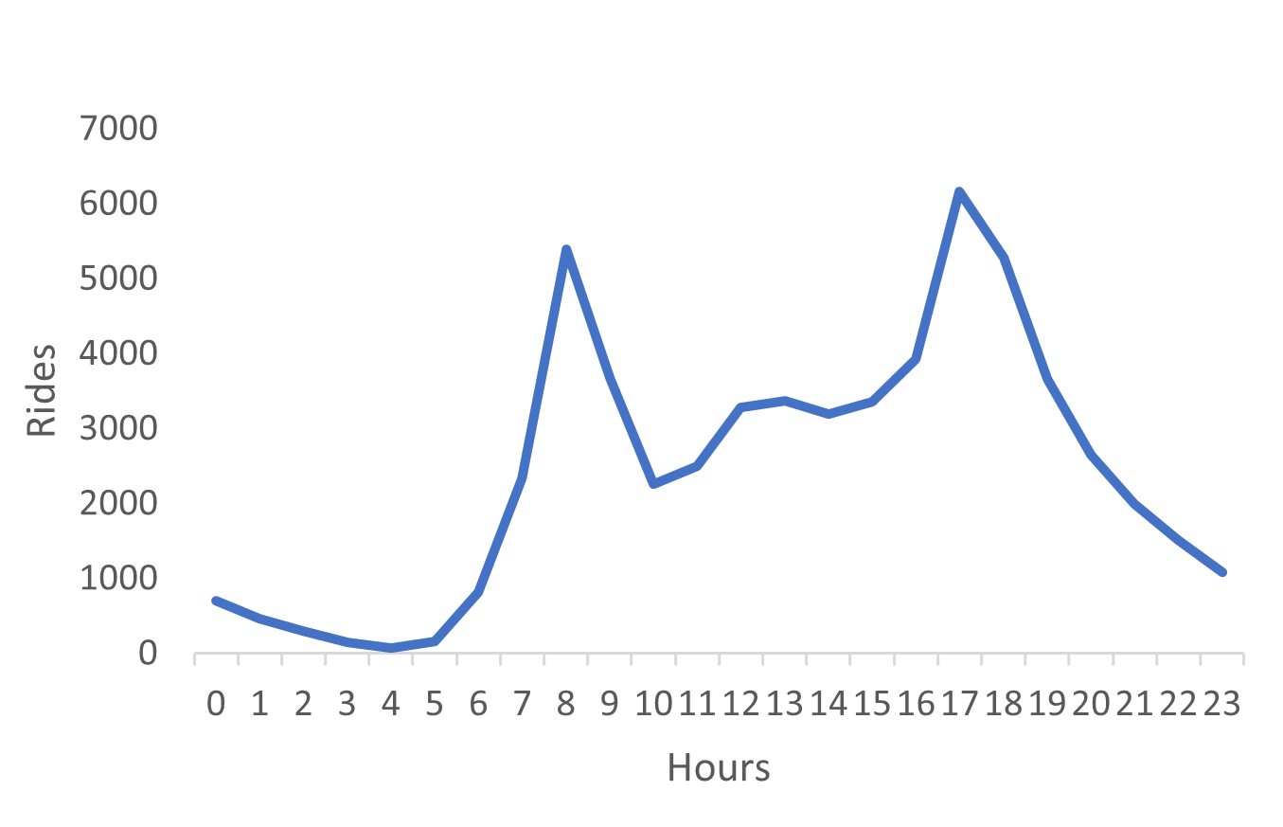
Rented Bike Count by Hour:
Demand is very High during rush hours of the day.
Rush hour is generally 8AM in morning & 5 PM in the evening.

Slide 10
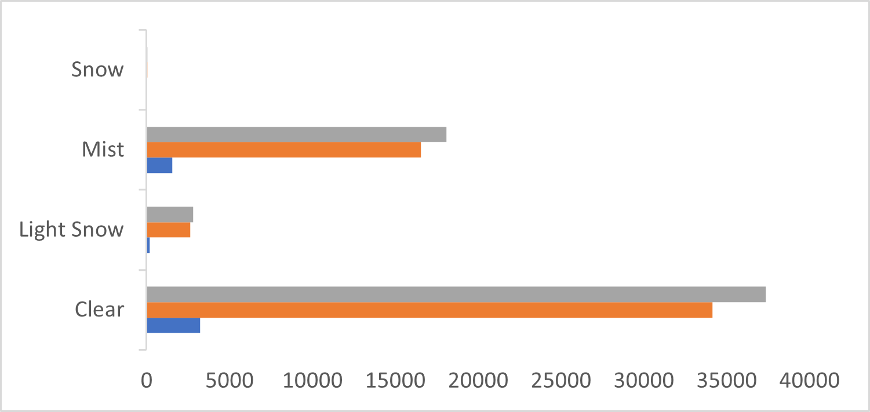
Bike Count by Weather:
During the Bright Clear day, demand of rides is Very High.
When the weather is Mist, demand is High because people prefer to ride during overcast, gloomy, murky, hazy day.
Registered users perform way more rides than casual ones.

Slide 11
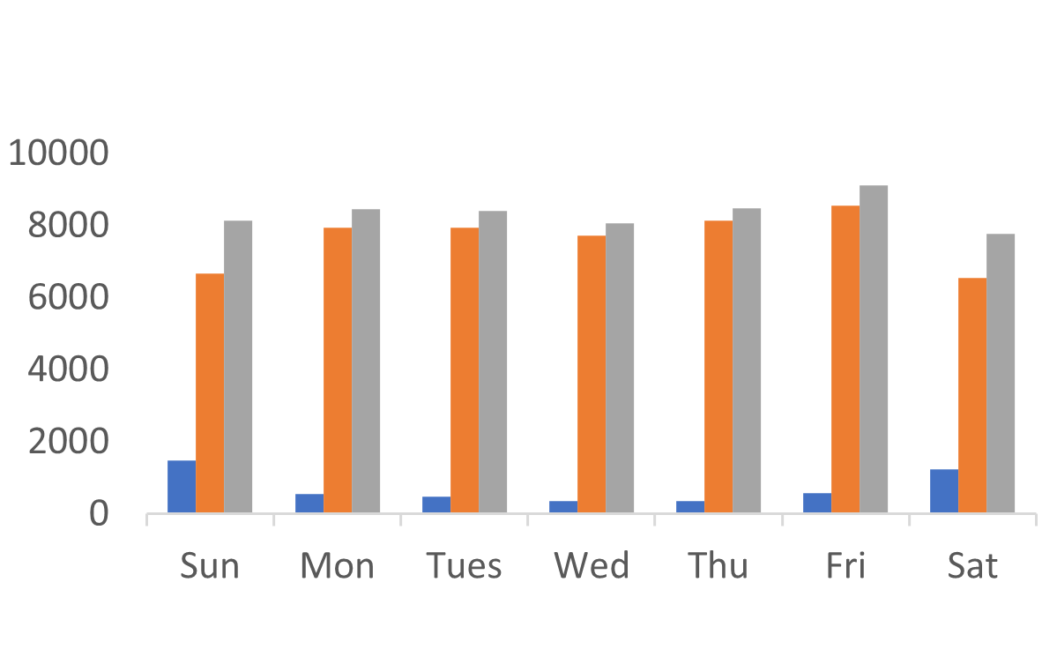
Bike Count by Days:
In weekend, registered users are decrease compared to weekdays, because people prefer to stay at home, spend time with family or maybe travel by other means of transport.
Number of registered rides are always above and significantly higher than casual rides.

Slide 12
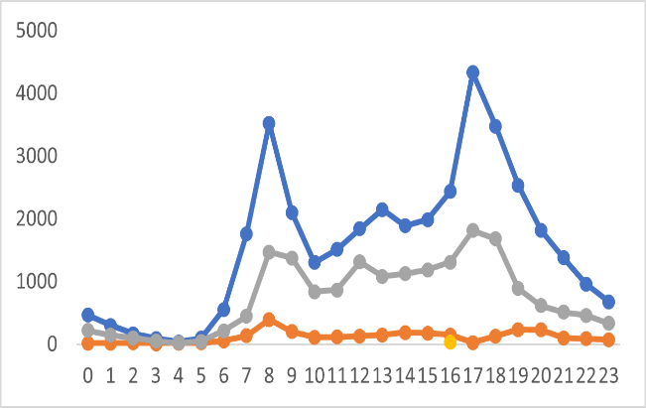
Bike Count by Weather and Hours:
During Clear weather, most people ride during peak hours.
During Mist, ride count are average.
While in snow or light snow, it is negligible because they enjoy weather rather than ride.

Slide 13
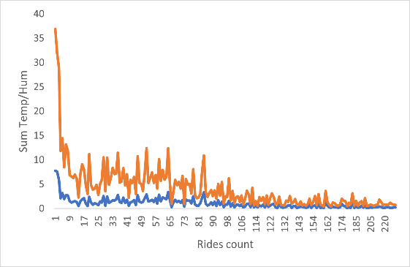
Bike count by Temperature & Humidity:
Temperature & humidity are inversely proportional to each others.
If temperature increase, it will reduce relative humidity, thus the air will become drier.
When the temperature decrease, the air will become wetter, therefore relative humidity will increase.

Slide 14

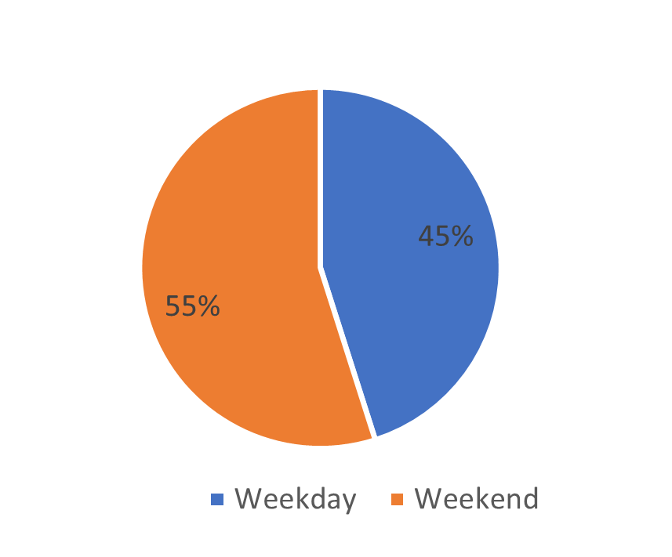
Bike Count by Weekend/Weekday:
Weekday, the number of rides are dominated over the weekend.
Out of total rides, 45% rides are in weekend while 55% are weekdays this shows people prefer bike rides for their office work, or school going children.

Slide 15
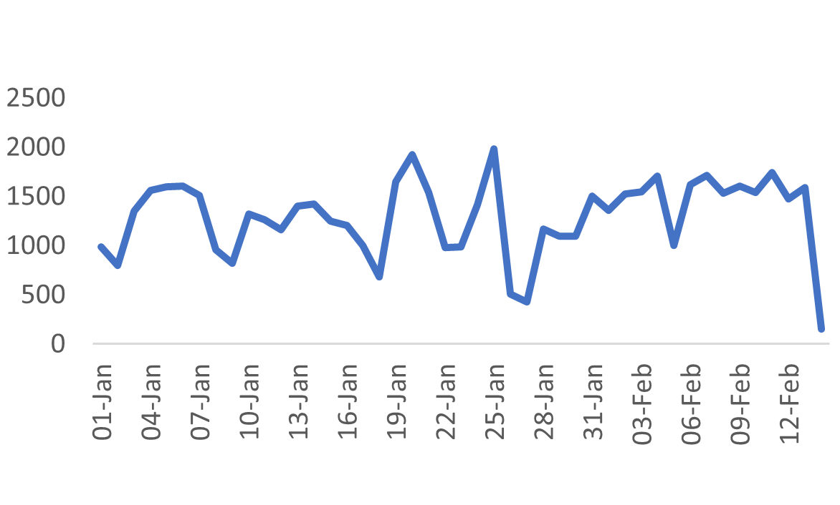
Bike Count by Datewise:
Every Saturday and Sunday, there is slight dip in the bike count.
During weekday start i.e. Monday the rides are increasing slow exponentially till Friday.

Slide 16
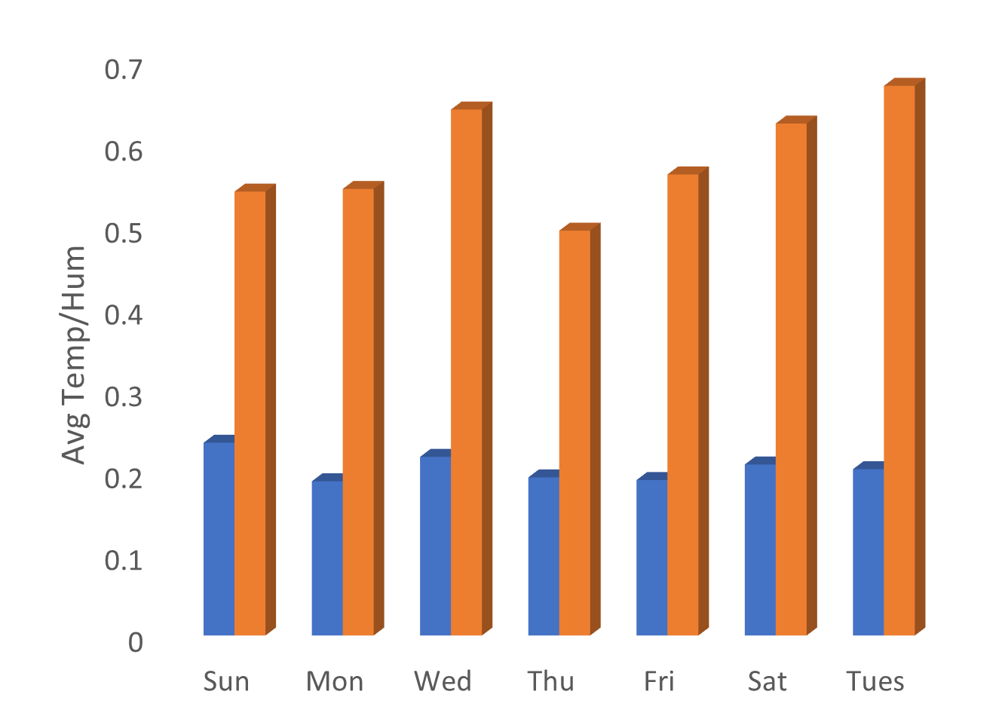
Daywise Temperature & Humidity:
Day wise effect of temperature and humidity.

Slide 17
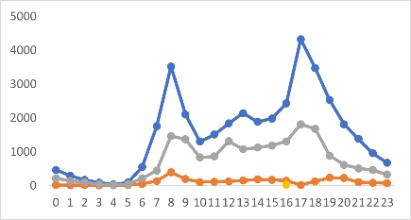
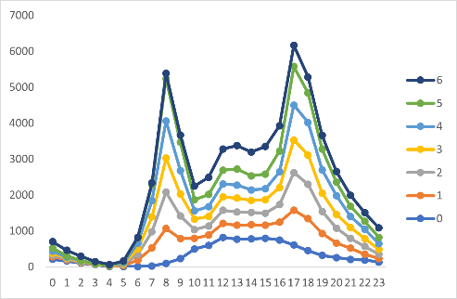
Bike Count by Weather & Weekdays with time:
Effect of weather(top graph) and weekdays(bottom graph) with time.
0-6 represent days of the weeks. 0 as sunday, 1 as monday and so on.

Slide 18
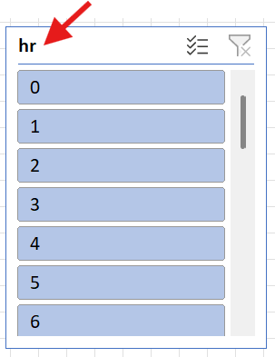
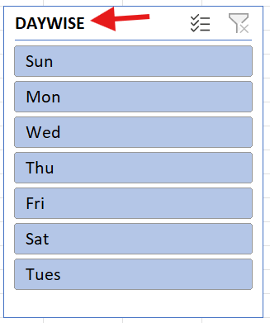
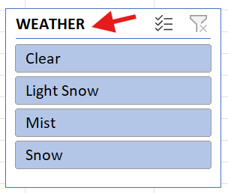
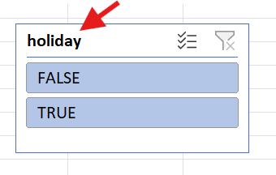
Slicers used for Bike Count:
Time in 24 Hrs
Weather for different classification
Day of the weeks
Holiday as Yes/No

Slide 19
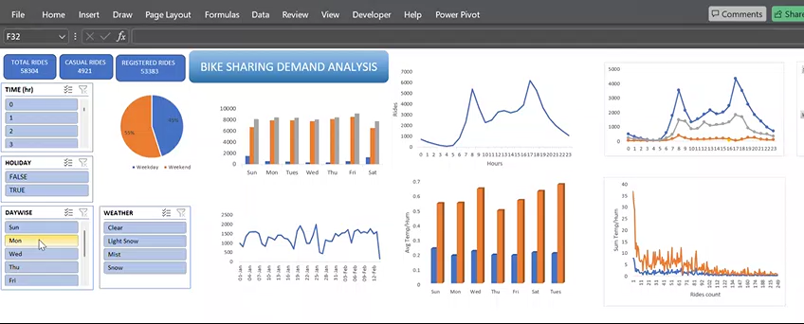
Dashboard:

Slide 20
Recommendations:
Promote some engaging activities for the weekend to attract bike ride.
Advertise how convenient and cost effective to use bike ride using billboard, paper ads, running campaign.

Slide 21


